Slide 1

Using H2O Random Grid Search for Hyper-parameters Optimization
Jo-fai (Joe) Chow
Data Scientist
joe@h2o.ai
Notes:
New face in PyData conference
Thanks for having me
I am Joe. I work for H2O.
Only joined 6 weeks ago
Not really a contributor to their code base – more like a long-term user (using H2O for my previous jobs since 2014)
Today’s talk is about one specific feature in H2O
Instead of giving you a full demo
Tell you a story from a user’s perspective

Slide 2
WHO AM I
Customer Data Scientist at H2O.ai
Background
Telecom (Virgin Media)
Data Science Platform (Domino Data Lab)
Water Engineering + Machine Learning Research (STREAM Industrial Doctorate Centre)
Notes:
A little bit more background of me
H2O – helping customers leverage H2O with their data, build smart apps
Before I joined H2O
VM – building data apps for CEO and CFO – answering specific business questions
Domino – evangelist – blogging and going to meetups and conferences
Before data science journey, I was a civil engineer – working on water related research

Slide 3
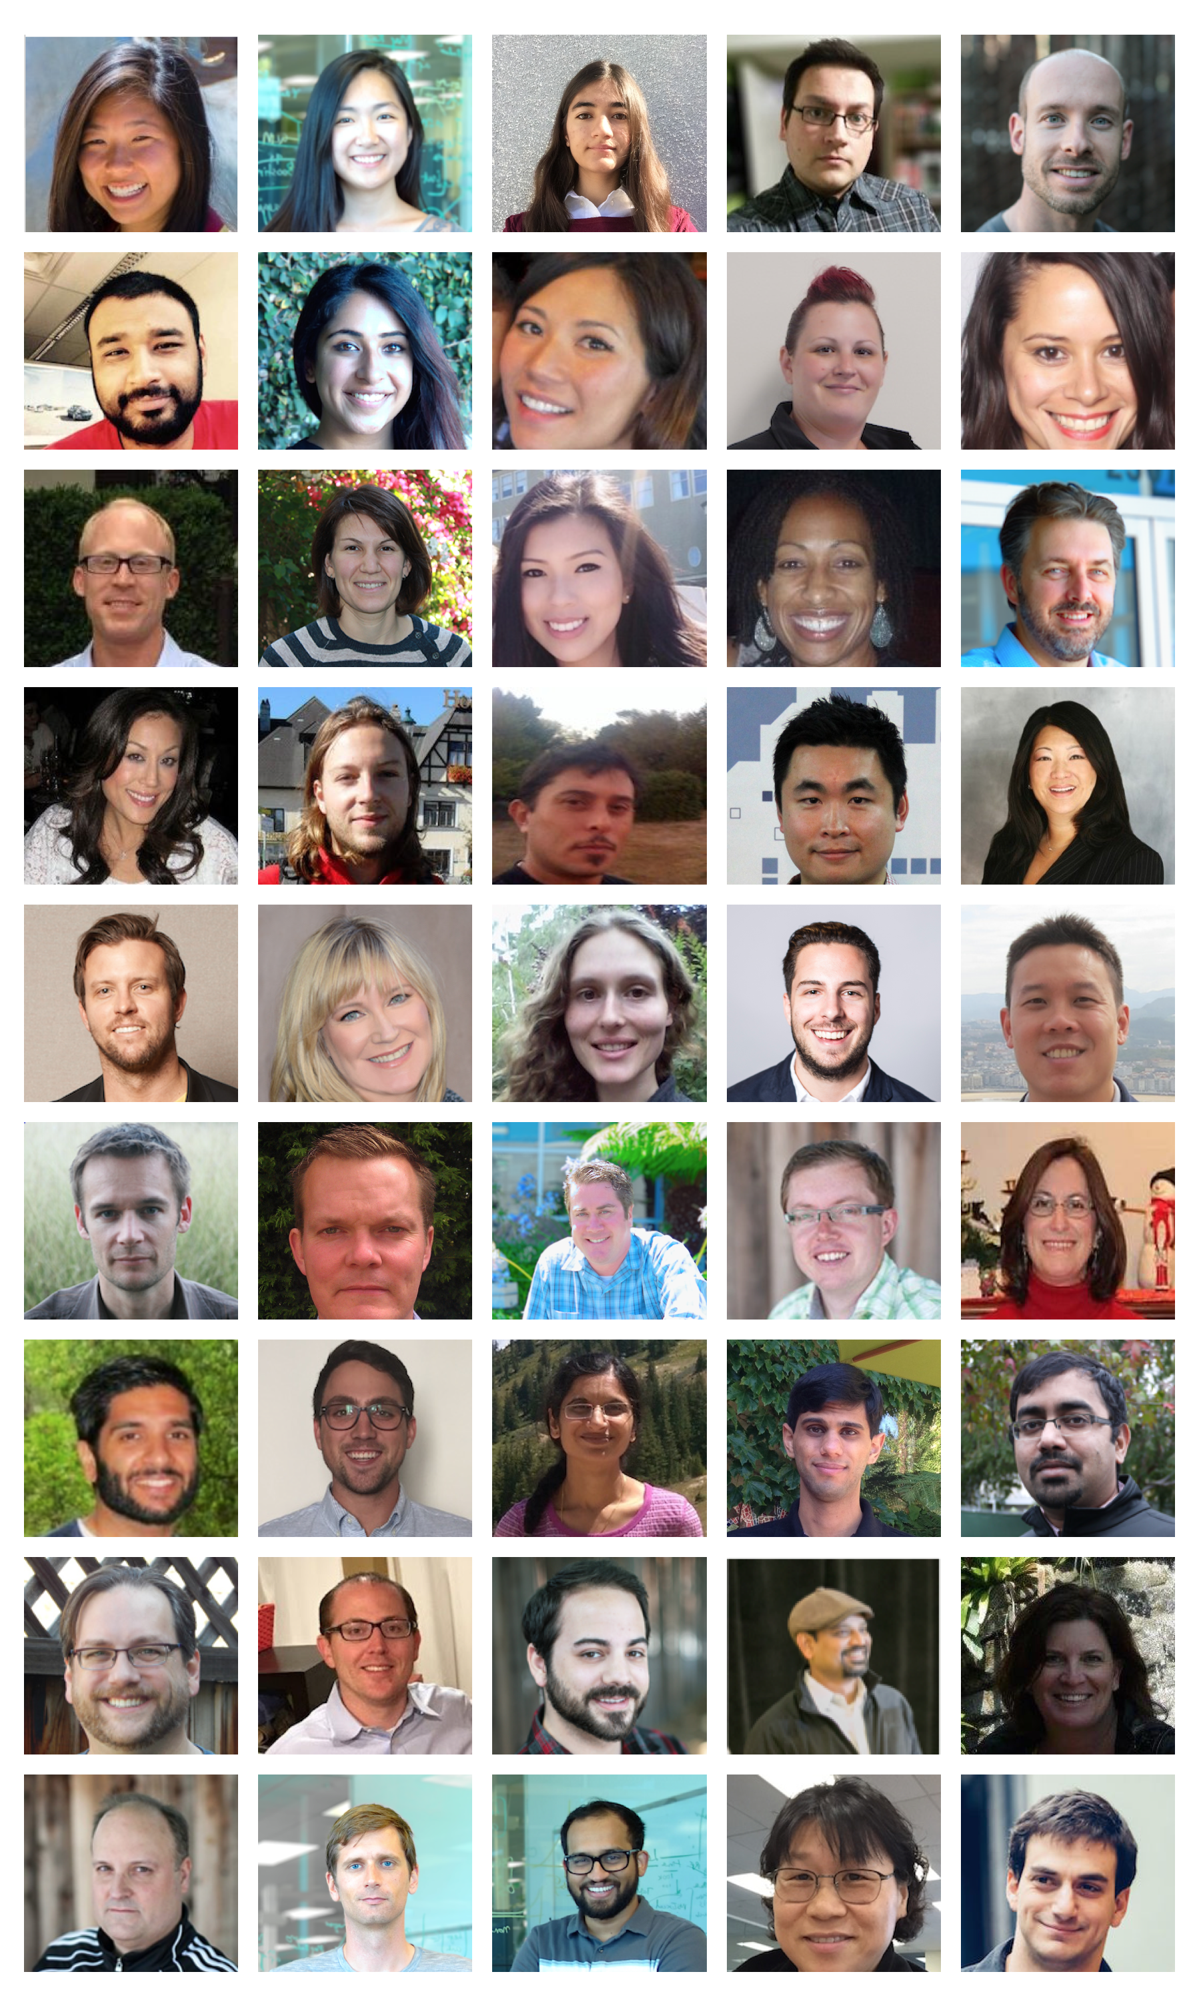
ABOUT H2O
Company
Team: 50 (45 shown)
Founded in 2012, Mountain View, California.
Venture capital backed
Products
Open-source machine learning platform.
Flow (Web), R, Python, Spark, Hadoop interfaces.
Notes:
Team is growing rapidly
Based in Mountain View – I am the only guy in UK/Europe
VC: $34M in total

Slide 4
ABOUT THIS TALK
Story of a baker and a data scientist
Why you should care
Hyper-parameters optimization
Common techniques
H2O Python API
Other H2O features for streamlining workflow
Notes:
Start with a story of baker / data scientist
Background information
Explain why you should care about the main topic – hyper-para tuning
What is it
Techniques
API
Other useful features in H2O

Slide 5
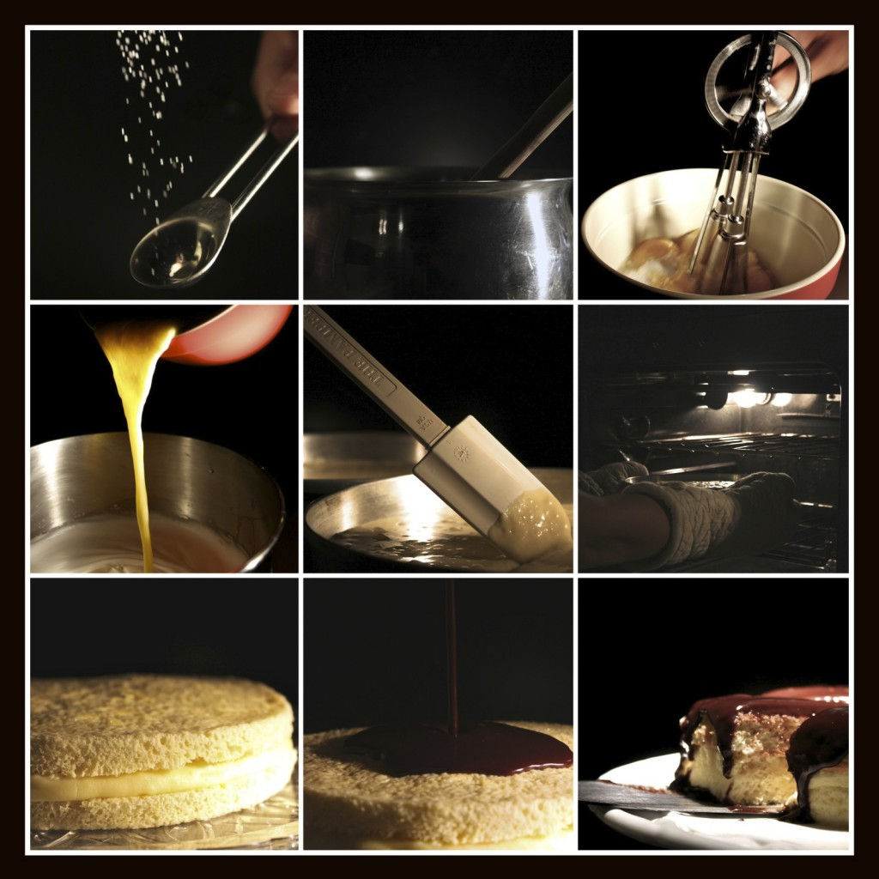
STORY OF A BAKER
Making a cake
Source
Ingredients
Process:
Mixing
Baking
Decorating
End product
A nice looking cake
Credit: www.dphotographer.co.uk/image/201305/baking_a_cake
Notes:
Start with a story
Or a workflow of making a cake

Slide 6
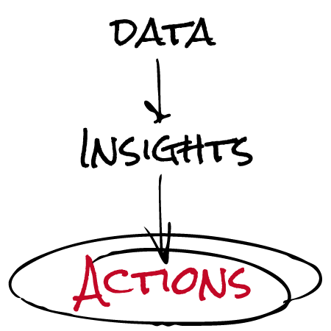
STORY OF A DATA SCIENTIST
Making a data product
Source
Raw data
Process:
Data munging
Analyzing / Modeling
Reporting
End product
Apps, graphs or reports
Credit: www.simranjindal.com
Notes:
Raw data – structured / unstructured / different databases

Slide 7
BAKER AND DATA SCIENTIST
What do they have in common?
Process is important to bakers and data scientists. Yet, most customers do not appreciate the effort.
Most customers only care about raw materials quality and end products.
Notes:
Customers don’t see much of the process

Slide 8
WHY YOU SHOULD CARE
We can use machine/software to automate some laborious tasks.
We can spend more time on quality assurance and presentation.
This talk is about making one specific task, hyper-parameters tuning, more efficient.

Slide 9
HYPER-PARAMETERS OPTIMISATION
Overview
Optimizing an algorithm’s performance.
e.g. Random Forest, Gradient Boosting Machine (GBM)
Trying different sets of hyper-parameters within a defined search space.
No rules of thumb.

Slide 10
HYPER-PARAMETERS OPTIMISATION
Example of hyper-parameters in H2O
Random Forest:
No. of trees, depth of trees, sample rate …
Gradient Boosting Machine (GBM):
No. of trees, depth of trees, learning rate, sample rate …
Deep Learning:
Activation, hidden layer sizes, L1, L2, dropout ratios …

Slide 11
COMMON TECHNIQUES
Manual search
Tuning by hand - inefficient
Expert opinion (not always reliable)
Grid search
Automated search within a defined space
Computationally expensive
Random grid search
More efficient than manual / grid search
Equal performance in less time

Slide 12
RANDOM GRID SEARCH – DOES IT WORK?
Random Search for Hyper-Parameter Optimization
Journal of Machine Learning Research (2012)
James Bergstra and Yoshua Bengio
“Compared with deep belief networks configured by a thoughtful combination of manual search and grid search, purely random search found statistically equal performance on four of seven data sets, and superior performance on one of seven.”

Slide 13
RELATED FEATURE – EARLY STOPPING
A technique for regularization.
Avoid over-fitting the training set.
Useful when combined with hyper-parameter search:
Additional controls (e.g. time constraint, tolerance)

Slide 14
H2O RANDOM GRID SEARCH
Objectives
Optimize model performance based on evaluation metric.
Explore the defined search space randomly.
Use early-stopping for regularization and additional controls.

Slide 15
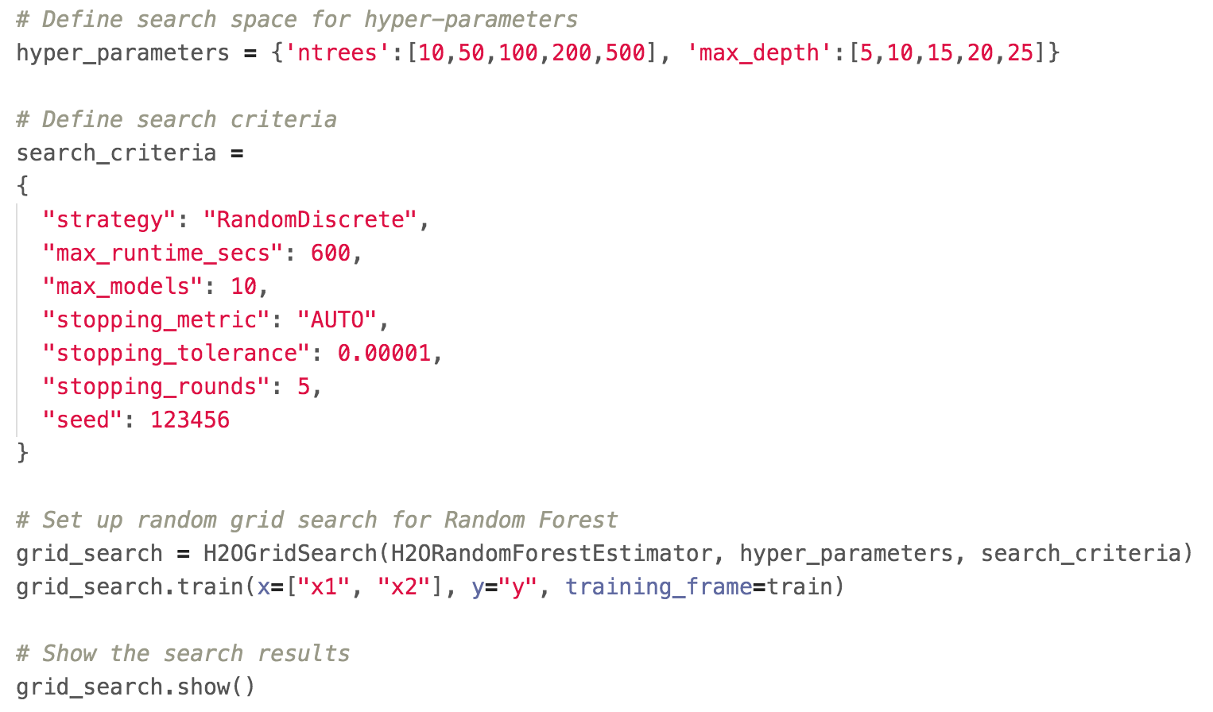
RANDOM GRID SEARCH (PYTHON API)

Slide 16
RANDOM GRID SEARCH
Outputs
Best model based on metric
A set of hyper-parameters for the best model
Other APIs
R, REST, Java (see documentation on GitHub)

Slide 17
OTHER H2O FEATURES
h2oEnsemble
Better predictive performance
Sparkling Water = Spark + H2O
Plain Old Java Object (POJO)
Productionize H2O models

Slide 18
CONCLUSIONS
Most people only care about the end product.
Use H2O random grid search to save time on hyper-parameters tuning.
Spend more time on quality assurance and presentation.

Slide 19
CONCLUSIONS
H2O Random Grid Search
An efficient way to tune hyper-parameters
APIs for Python, R, Java, REST
Do check out the code examples on GitHub
Combine with other H2O features
Streamline data science workflow

Slide 20
ACKNOWLEDGEMENTS
GoDataDriven
Conference sponsors
My colleagues at H2O.ai

Slide 21
THANK YOU
Resources
Slides + code – github.com/h2oai/h2o-meetups
Download H2O – www.h2o.ai
Documentation – www.h2o.ai/docs/
joe@h2o.ai
We are hiring – www.h2o.ai/careers/

